Slide 1
[ 레벨 요소 분석 ]
Person
State
- Gain, Lose
Bet
- Dollars
- Dog Number
Now Dollars
Betting
Gain or Lose
- Double or Nothing
Minimum Bet
- $5
Now Person Counter
Dog
State
- Winner, Loser
Counter
- 4

Slide 2
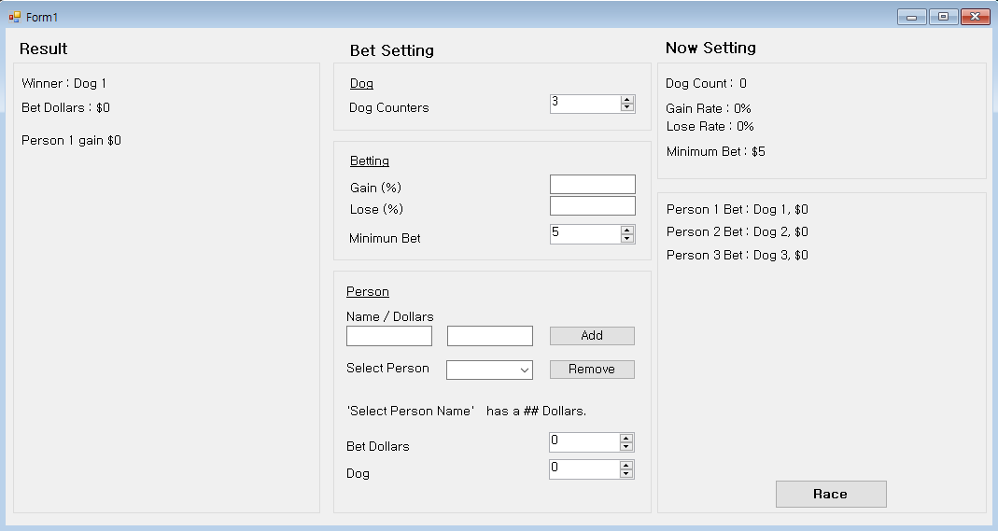
[ 레이아웃 구상 ]

